Slide 1
STOR 455 Class 30
Read: 10.1 - 10.4
Exercises: 10.19, 23, 24

Slide 2
Example: Predicting Medical School Acceptance
Data: MedGPA
Accept Status: A=accepted to medical school or D=denied admission
Acceptance Indicator for Accept: 1=accepted or 0=denied
Sex F=female or M=male
BCPM Bio/Chem/Physics/Math grade point average
GPA College grade point average
VR Verbal reasoning (subscore)
PS Physical sciences (subscore)
WS Writing sample (subcore)
BS Biological sciences (subscore)
MCAT Score on the MCAT exam (sum of CR+PS+WS+BS)
Apps Number of medical schools applied to
Find the “best” model for Acceptance using some or all of these predictors.

Slide 3
bestglm for Model Selection
Requirements to use bestglm()
Only the response and possible predictor variables should be within the dataframe
MedGPA.1 = within(MedGPA, {Accept = NULL})
The response variable must be the last column in the dataframe.
MedGPA.2 = MedGPA.1[,c(2:10,1)]

Slide 4
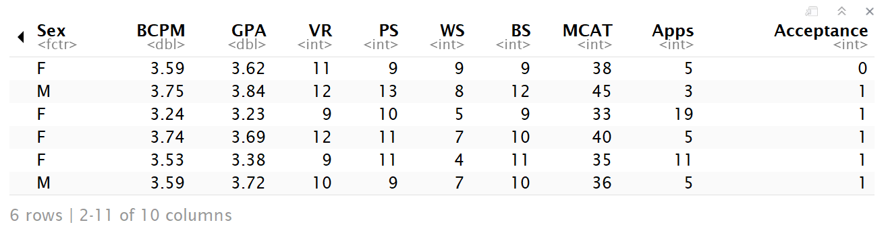
bestglm for Model Selection
head(MedGPA.2)

Slide 5
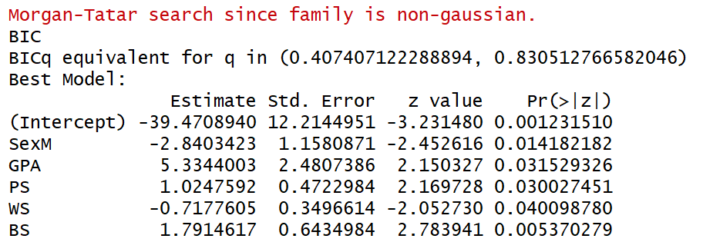
bestglm for Model Selection
bestglm(MedGPA.2, family=binomial)
Bayesian Information Criteria

Slide 6
Bayesian Information Criteria
n : sample size
k : number of predictors
θ : set of all parameters.
L(θ̂) :probability of obtaining the data which you have, supposing the model being tested was a given.
k log(n)- 2log(L(θ̂))
Selection criteria, similar to Mallow’s Cp
Smaller values indicate preferred models

Slide 7
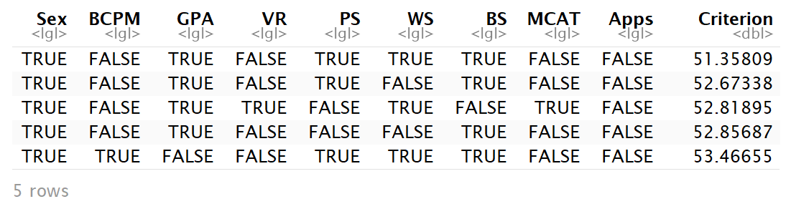
Comparing Models by BIC
ΔBIC | Evidence against higher BIC
0 to 2 | Little
2 to 6 | Positive
6 to 10 | Strong
>10 | Very strong
MedGPA.2.bestglm = bestglm(MedGPA.2, family=binomial)
MedGPA.2.bestglm$BestModels

Slide 8
Example: Predicting Survival
Data: ICU
ID Patient ID code
Survive 1=patient survived to discharge or 0=patient died
Age Age (in years)
AgeGroup 1= young (under 50), 2= middle (50-69), 3 = old (70+)
Sex 1=female or 0=male
Infection 1=infection suspected or 0=no infection
SysBP Systolic blood pressure (in mm of Hg)
Pulse Heart rate (beats per minute)
Emergency 1=emergency admission or 0=elective admission
Find the “best” model for Survival using some or all of these predictors.

Slide 9
bestglm for Model Selection
Requirements to use bestglm()
Only the response and possible predictor variables should be within the dataframe
ICU.1 = within(ICU, {ID = NULL})
The response variable must be the last column in the dataframe.
ICU.1 = ICU.1[,c(2:8,1)]

Slide 10
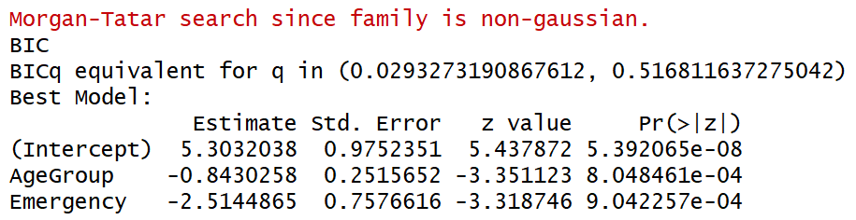
bestglm for Model Selection
bestglm(ICU.1, family=binomial)
Treated as quantitative

Slide 11
bestglm for Model Selection
Requirements to use bestglm()
Create dummy variables for non binary categorical variables.
ICU.2$AgeGroup2 = ifelse(ICU.2$AgeGroup==2,1,0)
ICU.2$AgeGroup3 = ifelse(ICU.2$AgeGroup==3,1,0)
#delete AgeGroup variable
ICU.3 <- within(ICU.2, {AgeGroup = NULL})
#reorder columns with response last
ICU.4 = ICU.3[,c(1:6,8,9,7)]

Slide 12
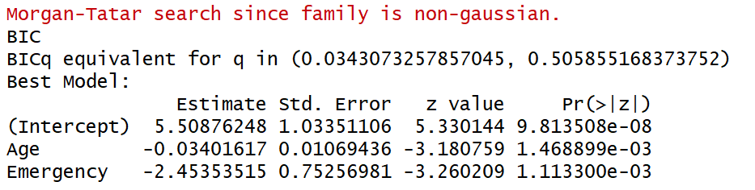
bestglm for Model Selection
bestglm(ICU.4, family=binomial)

Slide 13
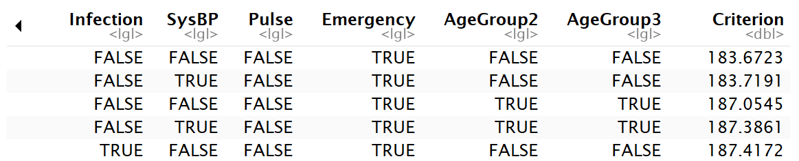
Comparing Models by BIC
ΔBIC | Evidence against higher BIC
0 to 2 | Little
2 to 6 | Positive
6 to 10 | Strong
>10 | Very strong
ICU.4.bestglm = bestglm(ICU.4, family=binomial)
ICU.4.bestglm$BestModels

Slide 14
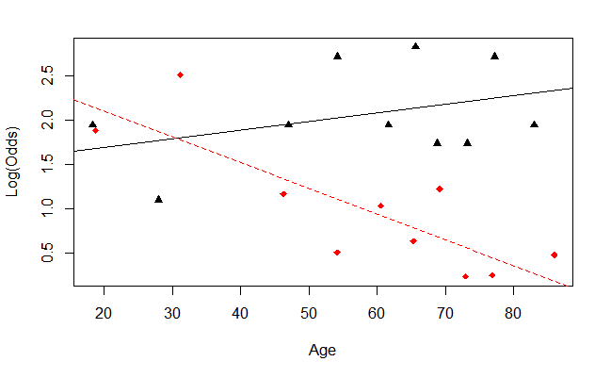
bestglm for Model Selection
emplogitplot2(Survive~Age+factor(Emergency), data=ICU.4, ngroups=10)

Slide 15


Slide 16
Issues with Insurance Data for bestglm
Currency_Convert <- function(Field){
Field <- as.numeric(gsub("\\$|,","", Field))
}
# Change factors to numbers
insurance$HOME_VAL_num = Currency_Convert(insurance$HOME_VAL)
insurance$INCOME_num = Currency_Convert(insurance$INCOME)
insurance$BLUEBOOK_num = Currency_Convert(insurance$BLUEBOOK)
insurance$OLDCLAIM_num = Currency_Convert(insurance$OLDCLAIM)

Slide 17
Issues with Insurance Data for bestglm
#remove unneeded variables
insurance.1 = within(insurance,
{INDEX = NULL
TARGET_AMT = NULL
HOME_VAL = NULL
INCOME = NULL
BLUEBOOK = NULL
OLDCLAIM = NULL}))

Slide 18
Predictor Selection Methods for Logistic Regression
All subsets bestglm
Backward elimination?
Forward selection?
Stepwise regression?

Slide 19
Stepwise Regression (Linear Regression)
Basic idea: Alternate forward selection and backward elimination
Use forward selection to choose a new predictor and check its significance.
Use backward elimination to see if predictors already in the model can be dropped.

Slide 20
Is there a package in R to automate this process?
Yes! The stepAIC function in the MASS package can be used.
Great! Can you show us how to use it?
No! Not yet…
Your task is to investigate the stepAIC function to determine how it can be used to determine the best logistic regression model using the insurance data

